Slide 1
p-2022-040
Bar Moskovich Noam Galili
Supervisors:
Prof. Mor M. Peretz
Mr. Guy Bar Sovik
Multi Sources Docking Station
The Center for Power Electronics and Mixed-Signal IC
Department of Electrical and Computer Engineering
Ben-Gurion University of the Negev, ISRAEL
Website: http://www.ee.bgu.ac.il/~pemic
march 2022

Slide 2
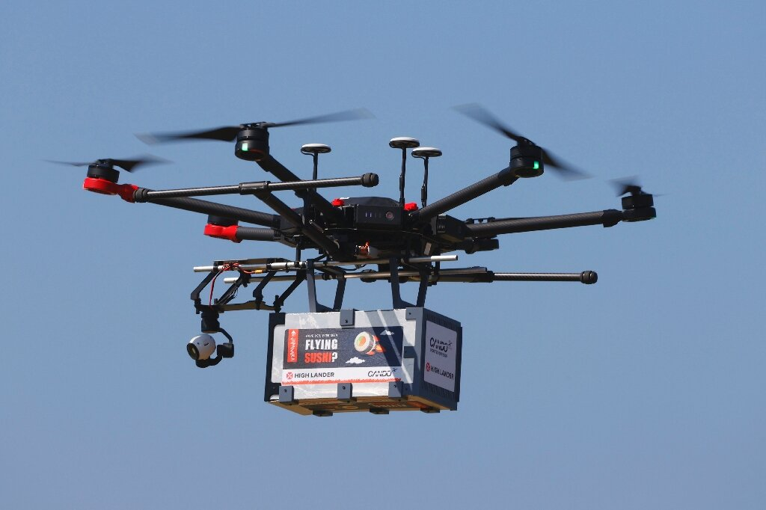


Introduction
In recent years drones have been integrated into the industry in numerous application: shipping, warfare, law enforcement, etc.
A major problem is long-term flight due limited battery lifetime of the drone
A solution is charging stations that will be on the drone's route on the way to the destination, using solar energy
Maximum power transfer requirement even when working conditions changes
For that, we need to stable the output voltage although the changes on the input voltage

Slide 3
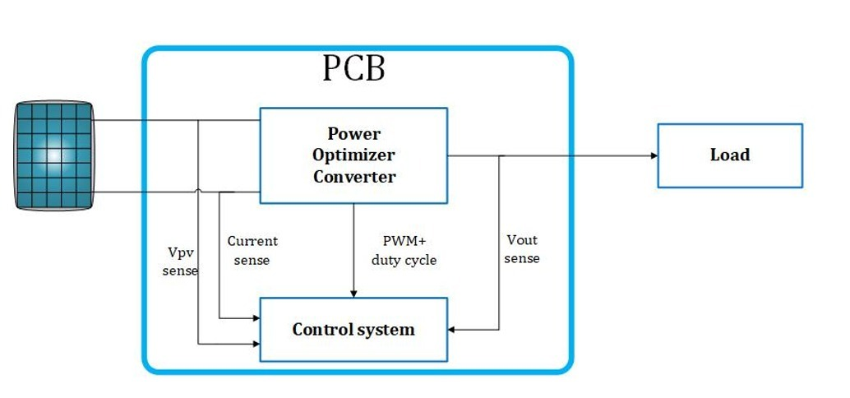
Project purpose
Efficiency~ 95%
Output voltage- 400V
Max output power- 240 W
Input voltage 20-40 V

Slide 4
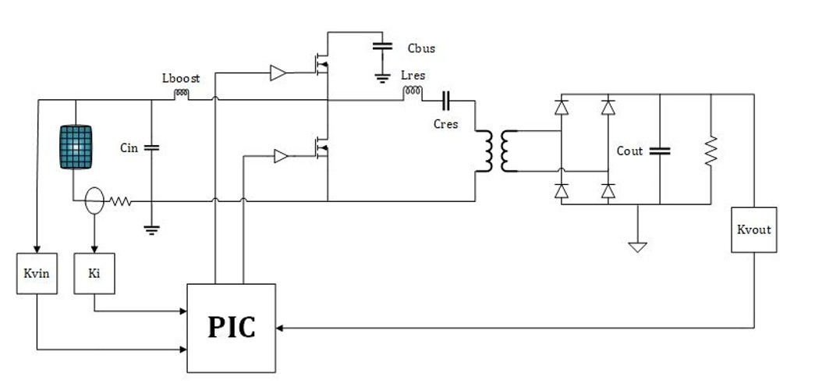
Merge PWM resonant converter

Slide 5
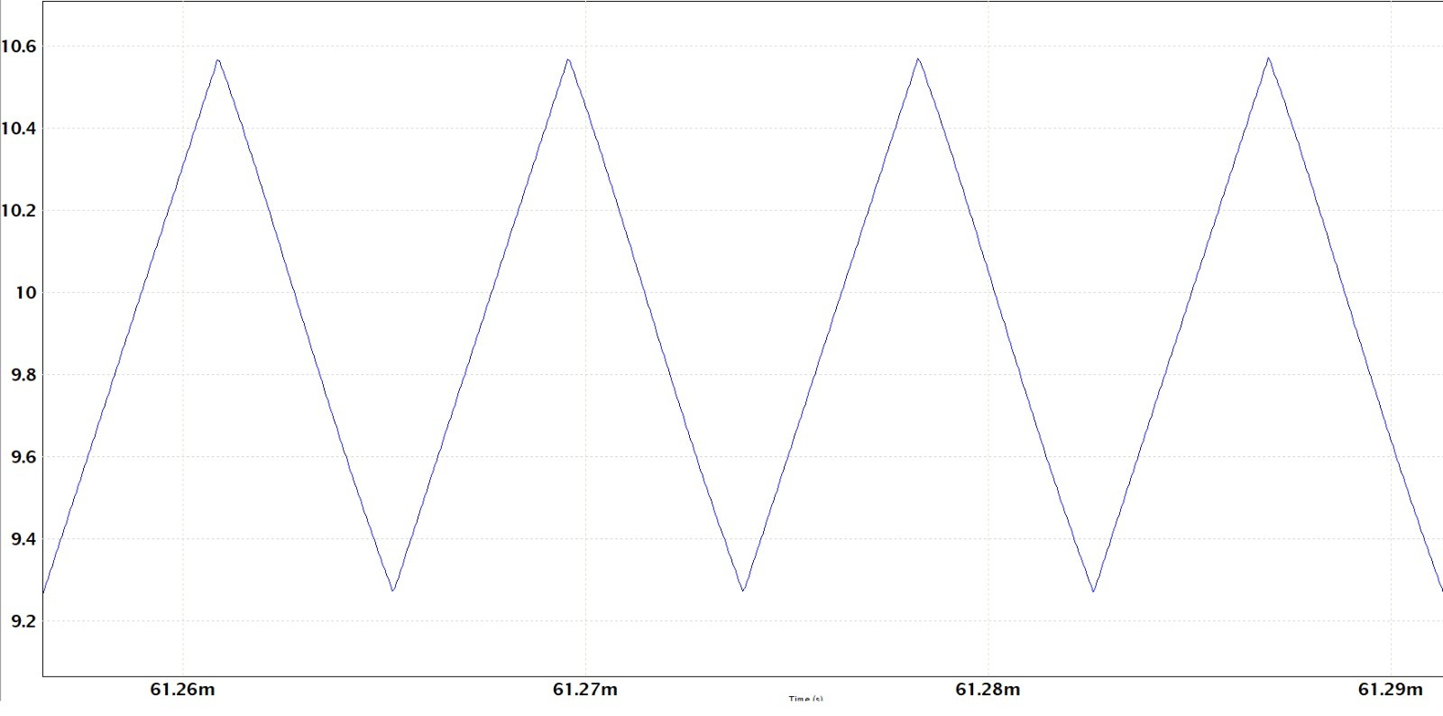
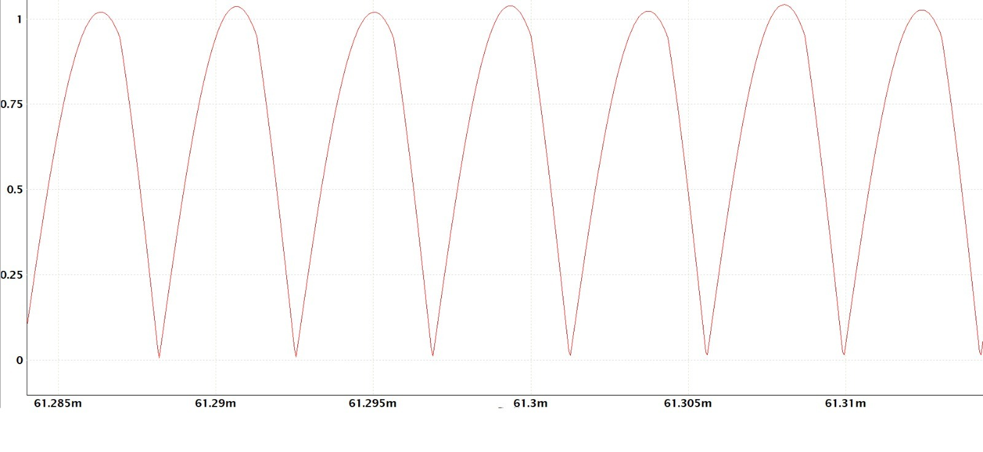
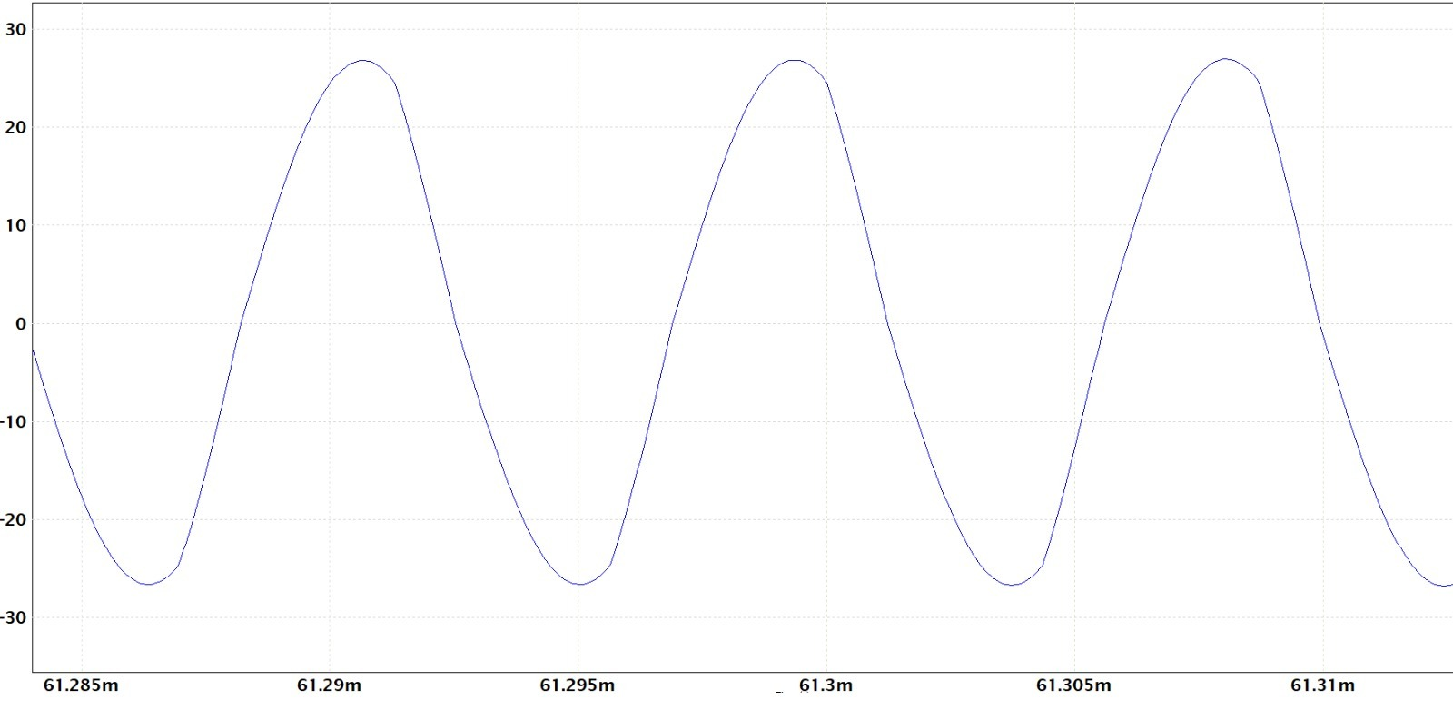
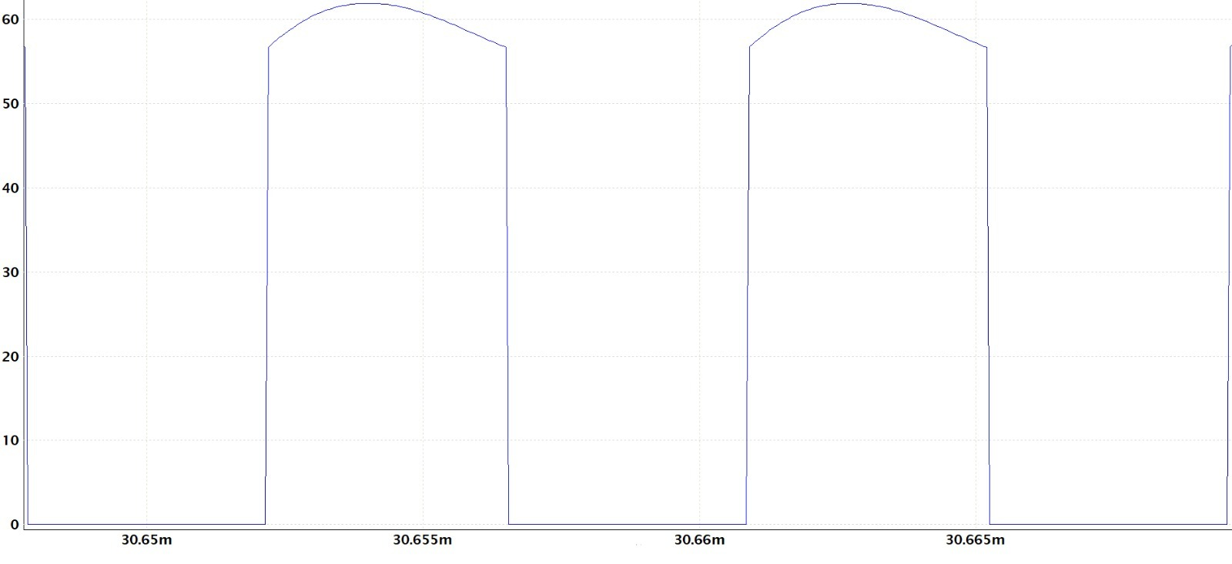
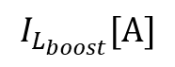
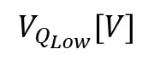
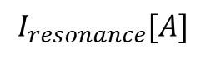
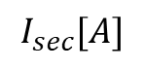
Circuit Simulation
$$I_{L_{boost}}[A]$$
$$I_{sec}[A]$$
$$I_{resonance}[A]$$
$$V_{Q_{Low}}[V]$$

Slide 6
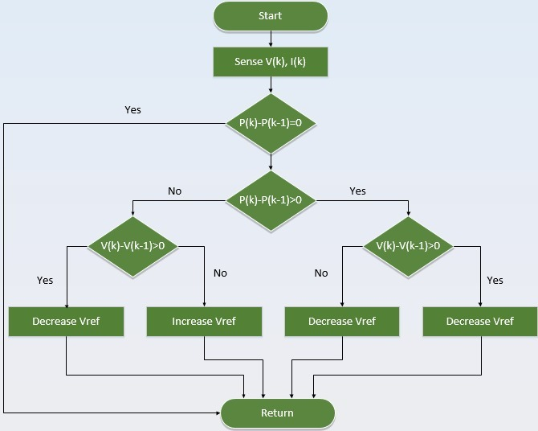
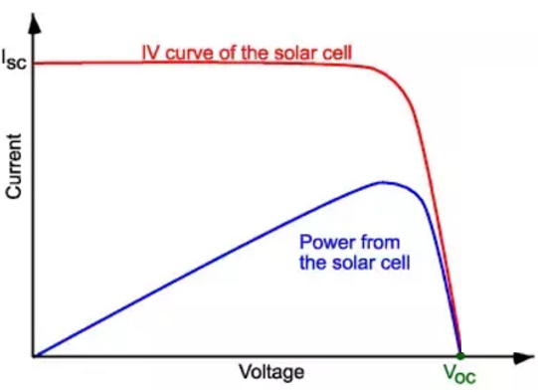
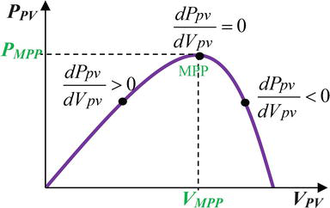
Voltage-Current Curve Of Solar Panel
Power curve depend on many variables: temperature, shadowing etc.
MPP Tracking- Maintaining work around an optimal work point

Slide 7
Project Main Problems
Components selection
Zero voltage switch (transistors)
Decrease transformer turns ratio
PIC application

Slide 8

PCB Design

Slide 9

Conclusions
The converter keep stable DC output voltage despite changes in input voltage
Independently control duty cycle and switch frequency allow us to stable the output voltage while achieving MPPT.

Slide 10
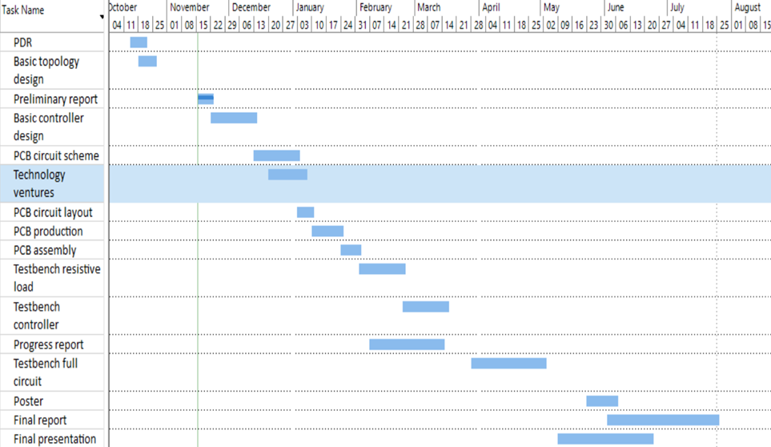

Project’s Tasks

Slide 11

Future work
Reduction of board dimensions
Efficiency improvement
DC/AC converter for same output voltage as the Israeli electrical grid

Slide 12


